Slide 1


University of Mumbai GHARDA INSTITUTE OF TECHNOLOGY Department of Computer Engineering
Academic Year 2022-23
Presented By
Experiment No-1
Pauras K. Ambekar 01
Snehal S. Awadan 02
Vaishnavi V. Bahutule 03
Saad K. Bebal 04
Siddhant S. Chalke 05
Sagar H. Chaughule 06
Shubhada S. Chaugule 07
Prachi P. Chavan 08
Samiksha P. Danawale 09
25th July , 2022

Slide 2
Install and Configure MongoDB and Execute NoSQL Command

Slide 3
Introduction
MongoDB is a document-oriented NoSQL database used for high volume data storage.
Each database contains collections(Table) which in turn contains documents(row/tuple).
Each document can be different with a varying number of fields.
There is no concept of primary key and foreign key
The size and content of each document can be different from each other.
The MongoDB environments are very scalable

Slide 4
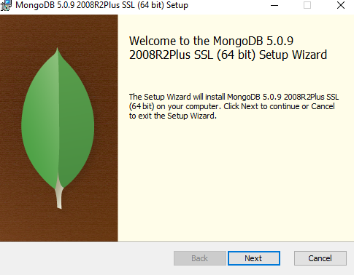
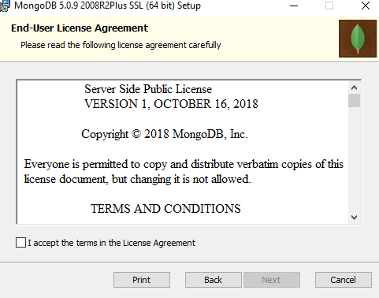
Installation and Configuration
Step 1:- Download MongoDB
Download the installer (.msi) from the MongoDB Download Center
Step 2:- Run the MongoDB installer

Slide 5
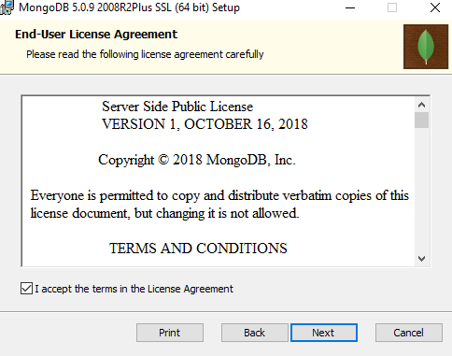
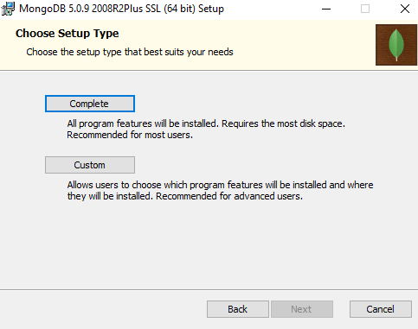

Slide 6
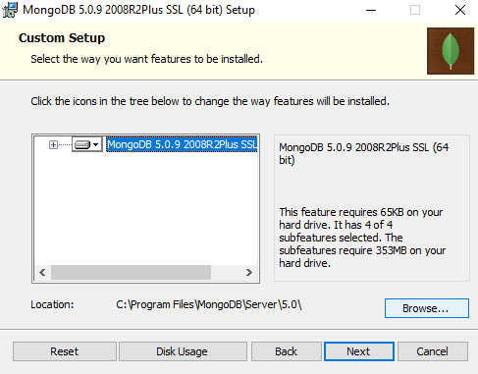
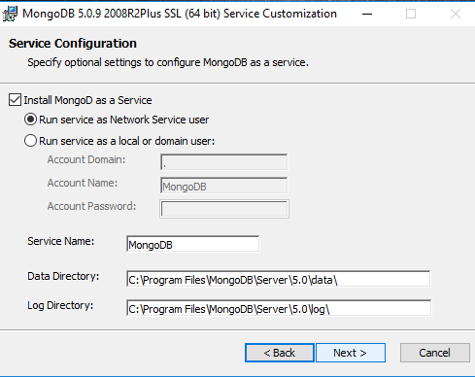

Slide 7
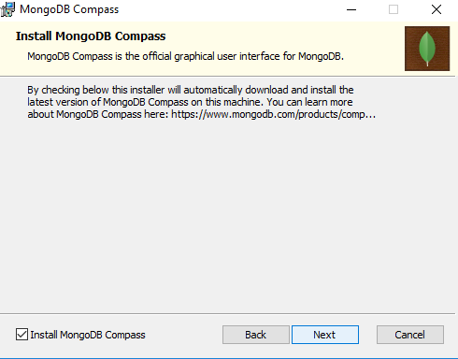
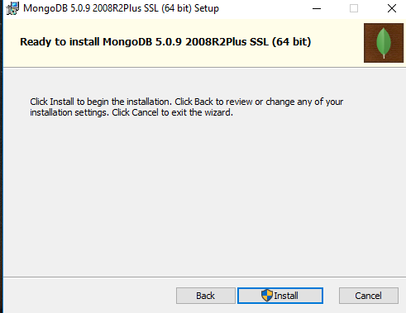

Slide 8
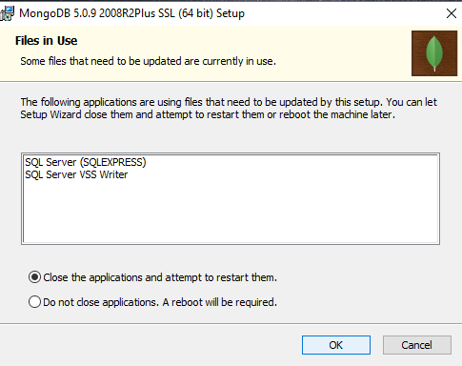
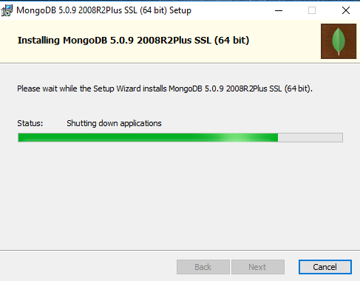

Slide 9

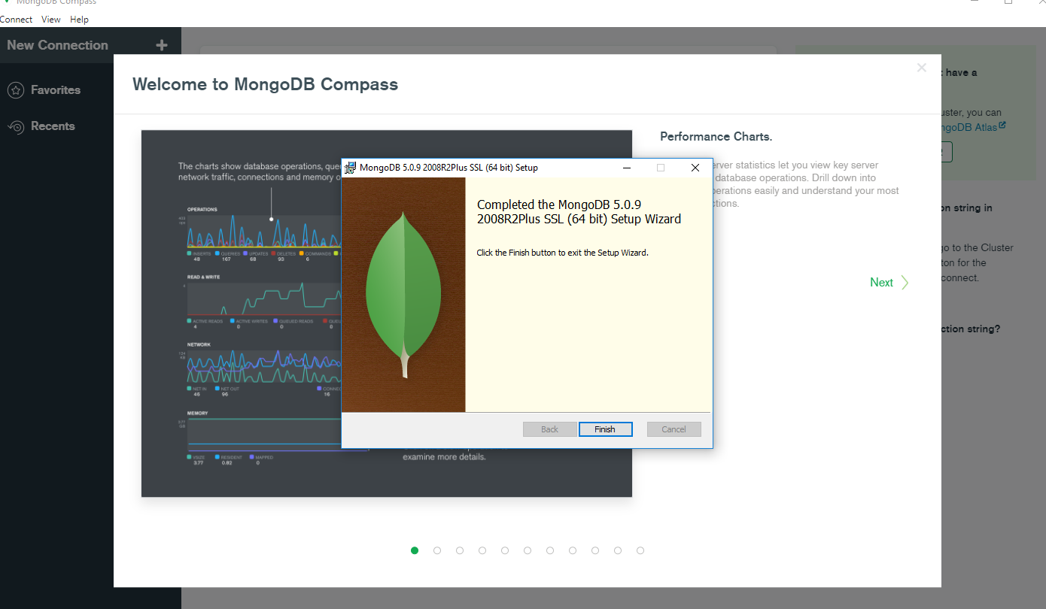
Successfully Install MongoDB

Slide 10
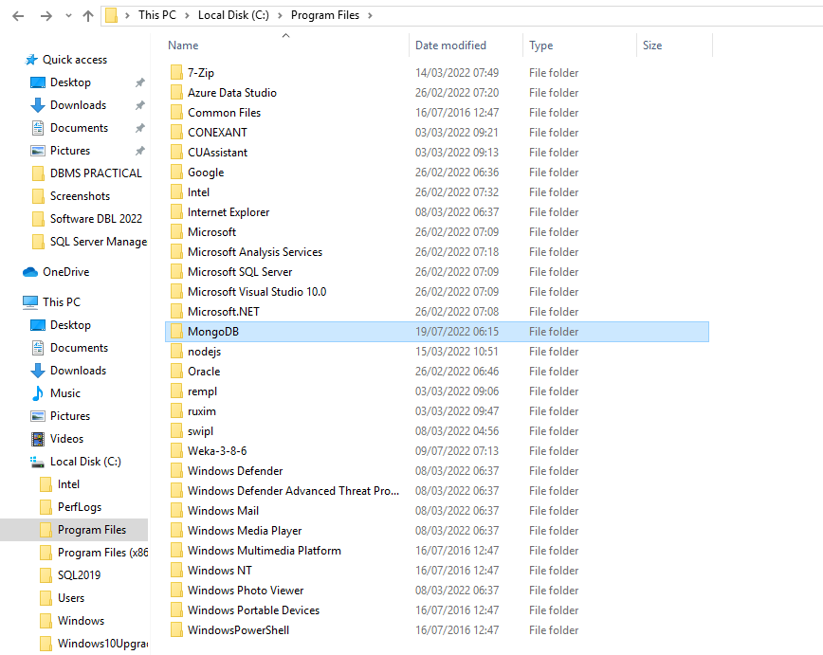
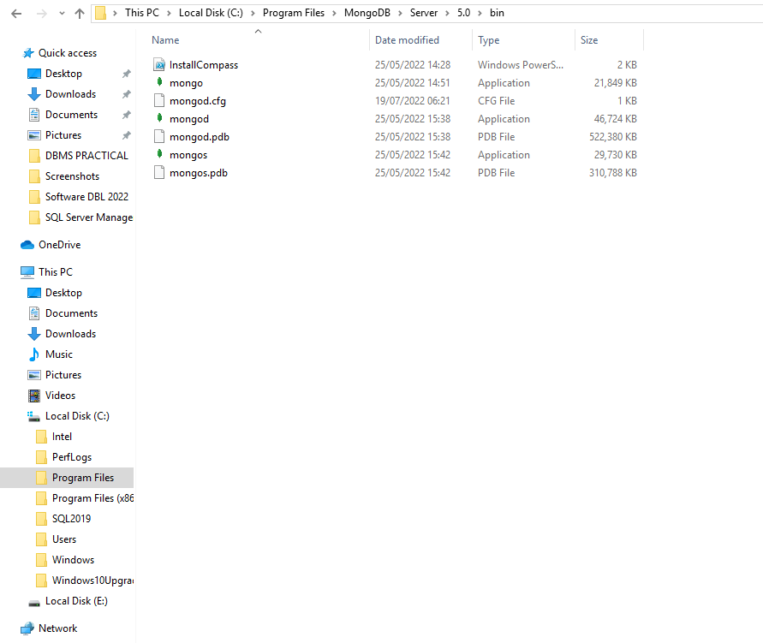
After installation set the PATH

Slide 11
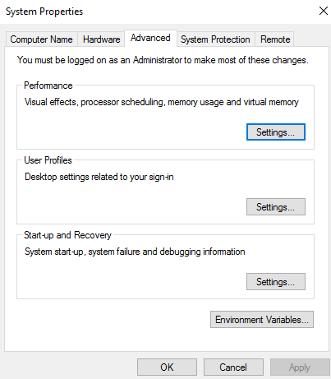
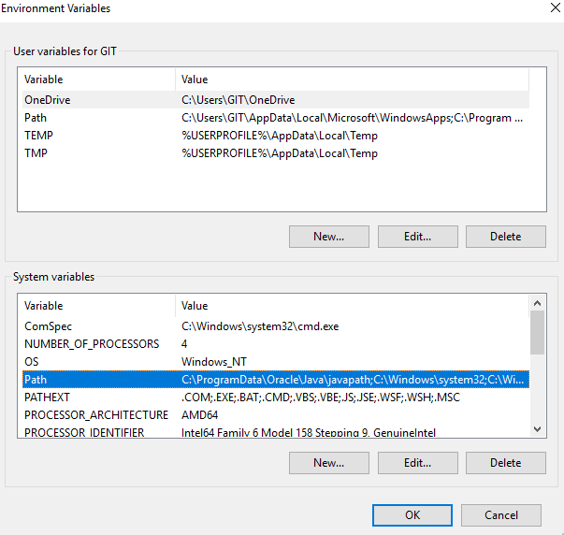

Slide 12
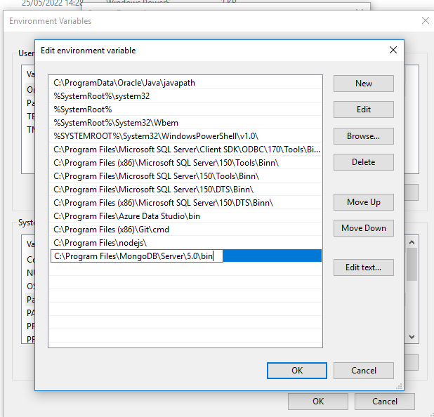

Slide 13
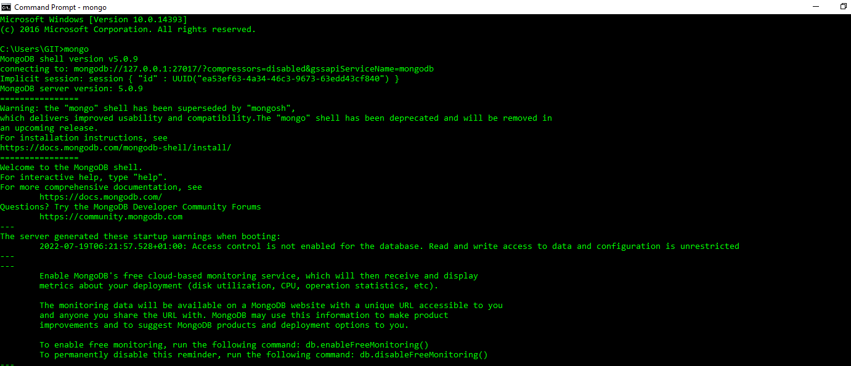
Now check MongoDB is install or not
Command: mongo

Slide 14
Commands
Show All Databases
use the show dbs command to list all databases on a MongoDB server. This will show you the database name, as well as the size of the database in gigabytes.
Syntax: show dbs
Example
Show dbs
local 0.000GB
Mydb 0.001GB
Tecadmin 0.083GB
2. Use
MongoDB use DATABASE_NAME is used to create database. The command will create a
new database if it doesn't&#39;t exist, otherwise it will return the existing database.
Syntax: use DATABASE_NAME
Example
use mydb
switched to db mydb

Slide 15
3. dropDatabase() method
MongoDB db.dropDatabase() command is used to drop a existing database.
Syntax: db.dropDatabase()
Example:
&gt;db.dropDatabase()
&gt;{ &quot;dropped&quot; : &quot;mydb&quot;, &quot;ok&quot; : 1 }
4.createCollection() Method
MongoDB db.createCollection(name, options) is used to create collection.
Syntax: db.createCollection(name, options)
Example:
&gt;use test
switched to db test
&gt;db.createCollection(&quot;mycollection&quot;)
{ &quot;ok&quot; : 1 }

Slide 16
5.drop() Method
MongoDB db.collection.drop() is used to drop a collection from the database.
Syntax: db.COLLECTION_NAME.drop()
Example:
&gt;db.mycollection.drop()
true
6.insert() Method
To insert data into MongoDB collection, you need to use MongoDB&#39;s insert() or save()
method.
Syntax: db.COLLECTION_NAME.insert(document)

Slide 17
7. find() Method
To query data from MongoDB collection, you need to use MongoDB&#39;s find() method. find()
method will display all the documents in a non-structured way. To display the results in a
formatted way, you can use pretty() method.
Syntax: db.mycol.find().pretty()
8. update() Method
The update() method updates the values in the existing document.
Syntax: db.COLLECTION_NAME.update(SELECTION_CRITERIA, UPDATED_DATA)

Slide 18
10. save() Method
The save() method replaces the existing document with the new document passed in the
save() method.
Syntax: db.COLLECTION_NAME.save({_id:ObjectId(),NEW_DATA})
11. remove() Method
MongoDB&#39;s remove() method is used to remove a document from the collection. remove()
method accepts two parameters. One is deletion criteria and second is justOne flag.
Syntax: db.COLLECTION_NAME.remove(DELLETION_CRITTERIA)

Slide 19
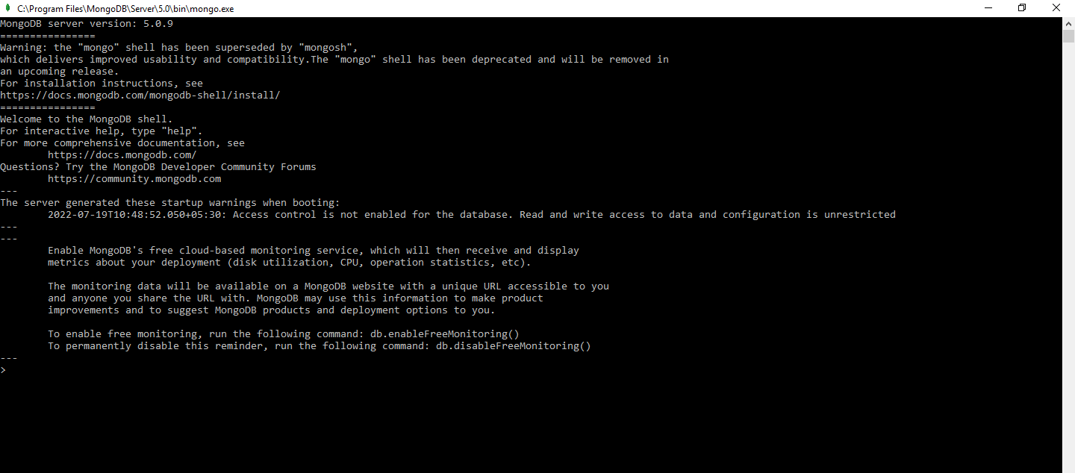
Executed Commands

Slide 20
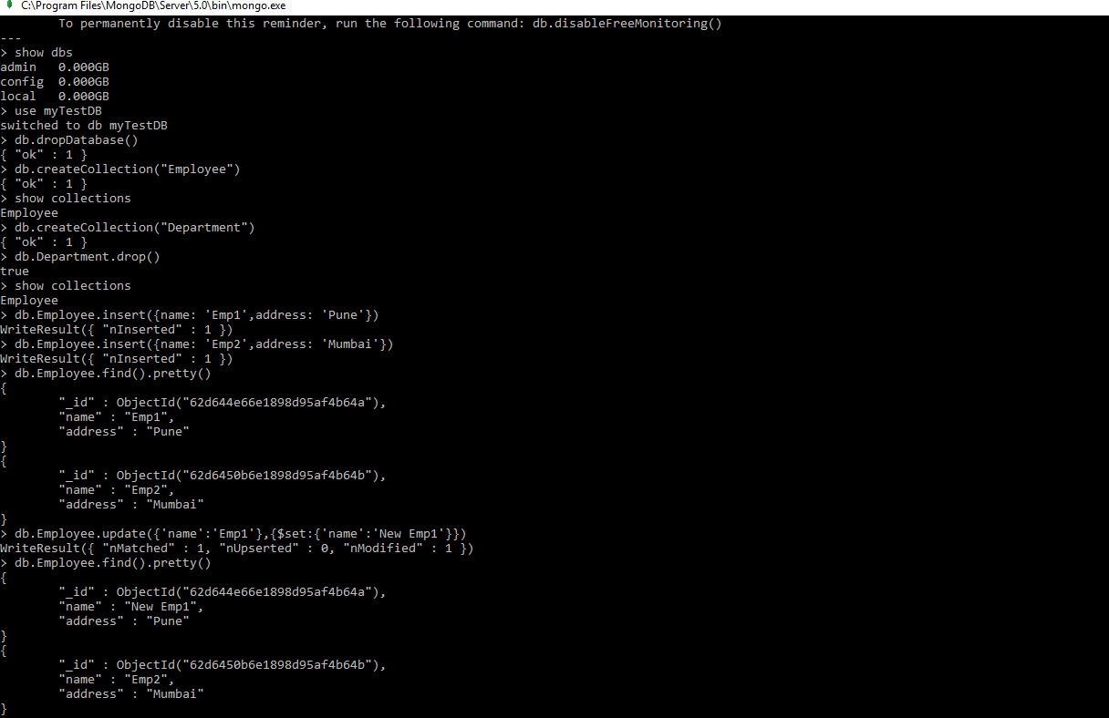

Slide 21
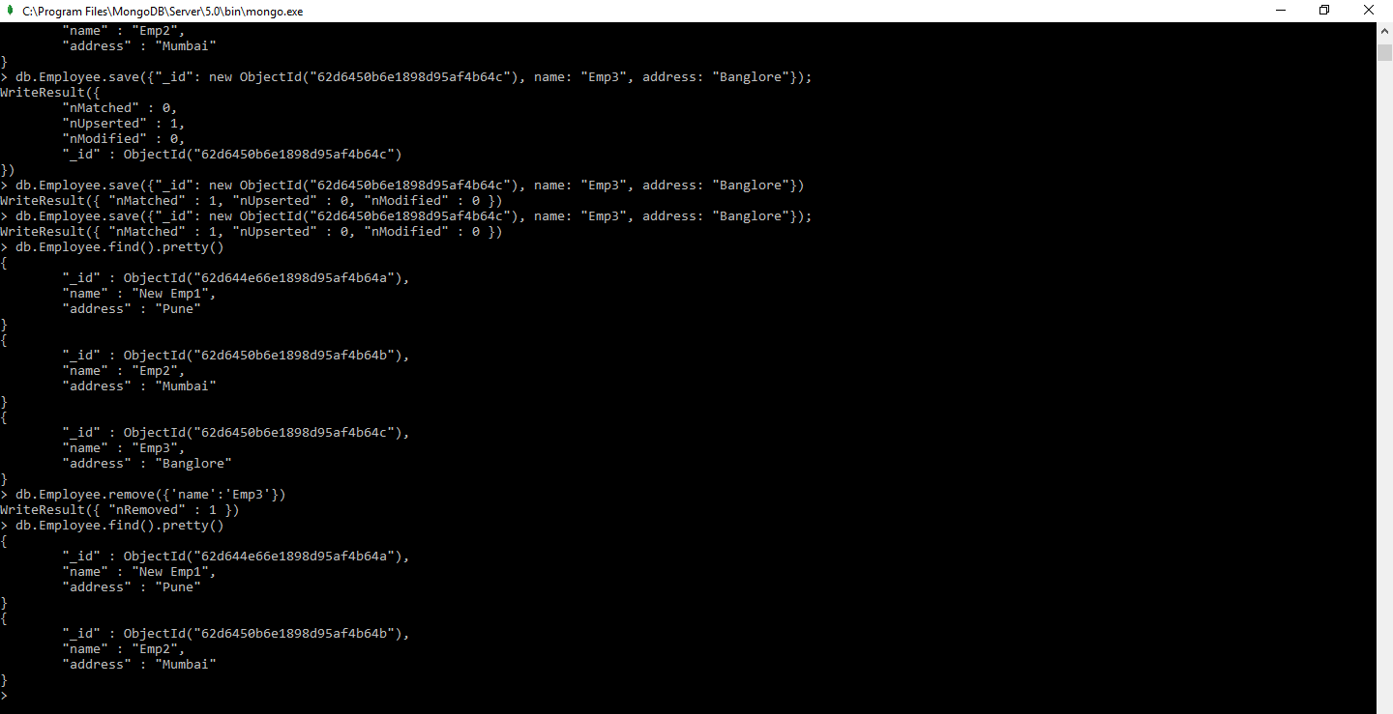

Slide 22
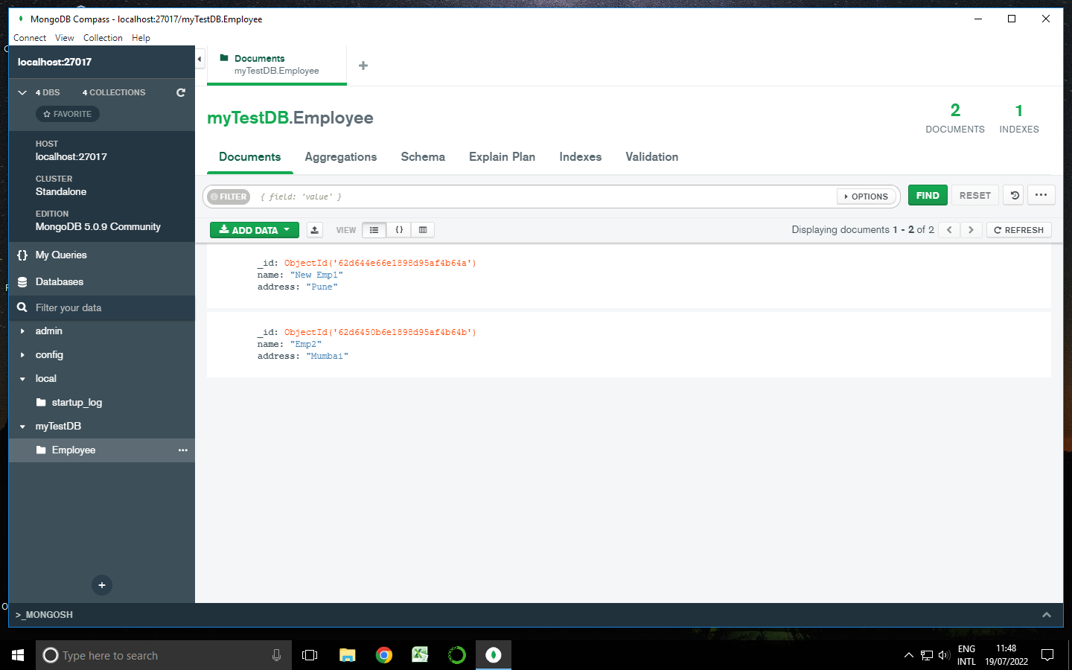
Demo Video:-https://drive.google.com/file/d/1q0cQc5jFm-jirZ-ijbSTGiOp38uAPSxo/view?usp=sharing

Slide 23
Thank You

